Slide 1
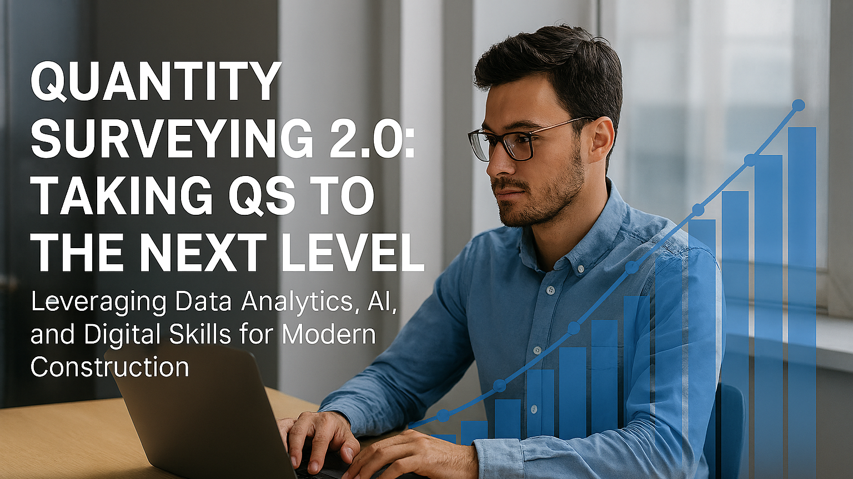

Slide 2
Lecture Presenter
Mohamed Ashour
Managing Data Analyst
QS – 8+ years exp.
Data Analytics – 5+ years exp.
MRICS, MBCS
Work placements across contractors, consultants & Clients.
Cost Intel Lead.
Tech Enthusiast
Linkedin: https://www.linkedin.com/in/mohamed-ashour-0727/

Slide 3
The QS 2.0 Transformation Journey
Act 1 → Overview
Act 2 → The Intelligence Revolution
Act 3 → The AI & Machine Learning Frontier
Act 4 → Digital Skillset
Act 5 → Bringing it all together

Slide 4
Act 1 - Overview

Slide 5



Today's Journey: From Traditional to Transformational
Where we've been: Manual processes, experience-based decisions, limited data usage
Where we are: Digital transition, data availability, technology adoption beginning
Where we're going: AI-assisted workflows, predictive intelligence, competitive advantage
Notes:
What you'll learn today:
How to leverage data for cost, time, and risk intelligence
Practical AI applications including fine-tuned models
Essential digital skills for the modern QS
How to start your own digital transformation
This is a 2-hour journey through QS transformation
We'll balance theory with practical demonstrations
Two live demos planned: Monte Carlo simulation and fine-tuned LLM
Encourage questions throughout

Slide 6
The Traditional QS - Where We've Been
Core Traditional Skills:
Measurement & Quantification: Manual take-offs, BOQ preparation, standard method of measurement
Cost Estimation: Historical cost databases, price books, supplier quotations
Contract Administration: Valuations, variations, final accounts
Commercial Management: Cash flow forecasting, cost control, reporting
Traditional Tools:
Excel spreadsheets for calculations
Cost databases (updated annually)
Paper drawings and specifications
Experience-based judgment and rules of thumb
Strengths of Traditional Approach:
Proven over decades
Clear professional standards
Human judgment and context understanding
Relationship-based practices
The Challenge:
Time-intensive processes
Limited ability to analyze large datasets
Reactive rather than predictive
Notes:
Presenter Notes:
Acknowledge the value of traditional skills (these don't disappear!)
These foundations are still critical
But the industry is generating more data than we can manually process
Transition: "So what's changing?"

Slide 7
The Digital Disruption - Where We're Going
1. Data Explosion:
BIM models generating granular data
IoT sensors on construction sites
Digital project management platforms
Historical project databases
2. Technology Advancement:
Cloud computing enabling massive calculations
AI/ML making predictions possible
Automation handling repetitive tasks
APIs connecting systems seamlessly
3. Industry Pressures:
Tighter margins demanding efficiency
Complexity requiring better risk management
Speed-to-market expectations
Sustainability and ESG reporting needs
4. Skills Gap:
Aging workforce with traditional skills
Young professionals bringing digital fluency
Clients expecting data-driven insights
Competition from tech-savvy firms
Notes:
The Opportunity:
Transform from cost accountant to strategic advisor
Predictive rather than reactive practice
Scale expertise through automation
Deliver insights, not just numbers
Presenter Notes:
We're not replacing QS professionals—we're augmenting them
Technology handles volume; humans handle judgment
Those who adapt will lead the industry
Transition: "Let's gauge where you are in this journey"

Slide 8
Interactive Poll
Go to www.Menti.com
Use the code 7462 6255

Slide 9
Act 2 - The Intelligence Evolution

Slide 10
The Three Pillars of Intelligent Quantity Surveying
1. Cost Intelligence
Understanding not just what things cost, but WHY
Predicting future cost movements
Identifying anomalies and opportunities
Real-time market intelligence
2. Time Intelligence
Understanding schedule dynamics and changes
Impact analysis of delays
Predictive scheduling
Time-cost relationship optimization
3. Risk Intelligence
Quantifying uncertainty
Probability-based forecasting
Scenario modeling
Evidence-based contingency planning

Slide 11
Cost Intelligence: Beyond Historical Pricing
Traditional Cost Approach:
Look up historical rates
Apply location and time adjustments
Add contingency (often arbitrary percentage)
Hope it's accurate
Cost Intelligence Approach:
Analyze hundreds of data points per cost item
Understand cost drivers and correlations
Identify trends and patterns
Predict with confidence intervals

Slide 12
Cost Intelligence Key Components
1. Multi-dimensional Cost Analysis
Cost by: location, time, supplier, project type, specification
Understanding variance factors
Correlation analysis (what affects what?)
2. Real-time Market Intelligence
Material price tracking
Labor market conditions
Supply chain disruptions
Economic indicators
3. Predictive Cost Modeling
Regression analysis for cost trends
Seasonal adjustment factors
Escalation forecasting
Risk-adjusted pricing
4. Anomaly Detection
Identifying outliers in quotes
Spotting unusual cost patterns
Early warning systems for cost overruns
Notes:
Presenter Notes:
Cost intelligence is about understanding context
Data tells stories if you know how to listen
This requires systematic data collection
Transition: "Let me show you specific techniques"

Slide 13





Analytical Techniques for Cost Insights
1. Regression Analysis
Identify cost drivers: "What makes this more expensive?"
Quantify relationships: "Each floor adds £X"
Build predictive models
Example: Building height vs. structure cost per m²
2. Clustering & Segmentation
Group similar projects together
Identify project archetypes
Targeted benchmarking
Example: "Your project clusters with 15 similar office fits-outs"
3. Time Series Analysis
Trend identification and forecasting
Seasonal patterns (e.g., Q1 labor shortages)
Escalation modeling
Example: "Steel prices follow 18-month cycles"
4. Variance Analysis
Statistical distributions of costs
Standard deviation and confidence intervals
Outlier detection
Example: "95% of similar projects: £850-£1,100/m²"
Notes:
Data Sources to Leverage:
Internal project histories
External market data (indices, commodity prices)
Supplier and subcontractor databases
Government statistics and economic data
Industry benchmarking services
Presenter Notes:
Don't worry if this sounds technical—we'll cover learning paths
Start simple: Excel pivot tables and charts
Progress to programming for automation
Transition: "A critical piece is having good data to analyze"

Slide 14
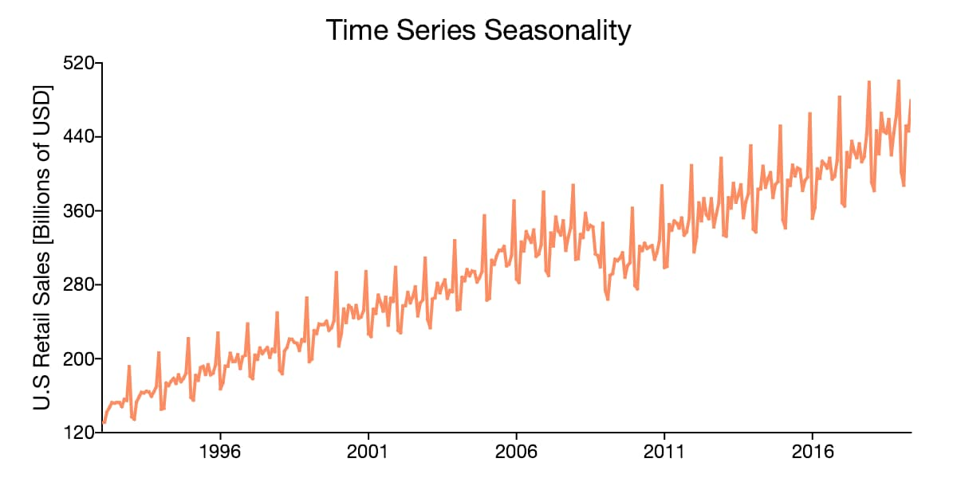
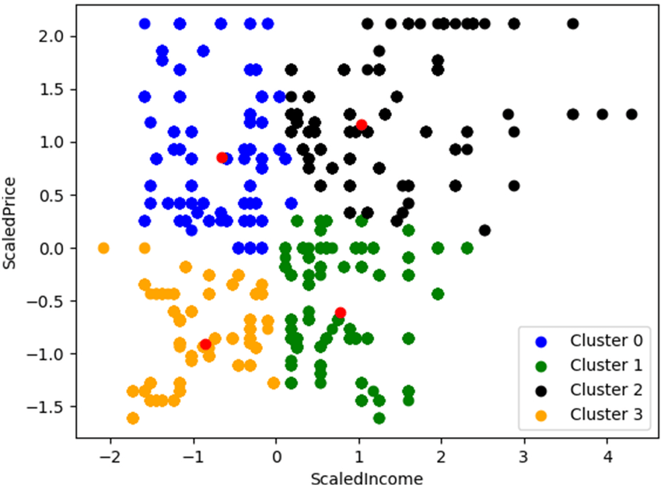
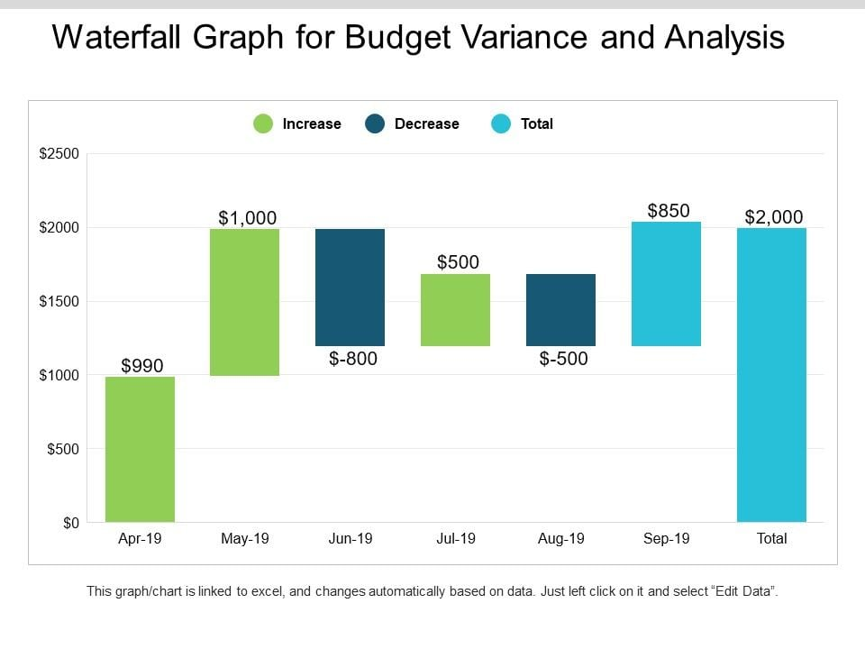
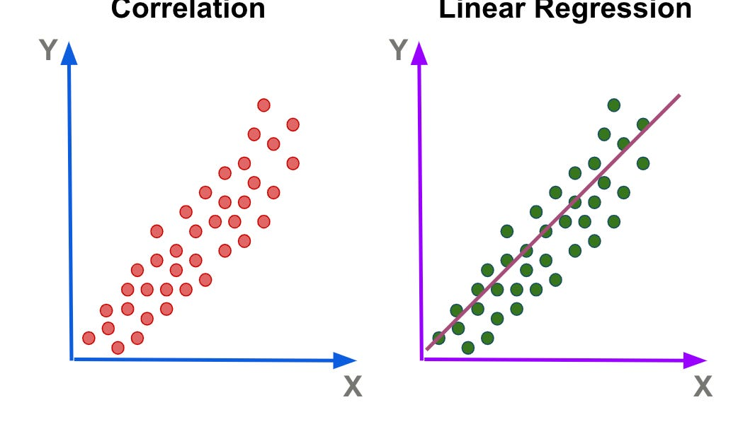
Analytical Techniques for Cost Insights

Slide 15
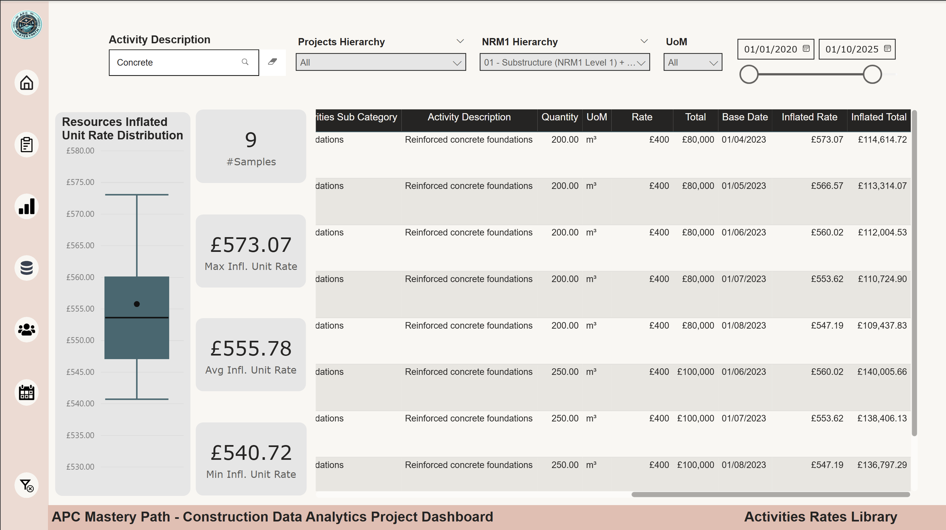
Use Case - Creating an Intelligent Resources Database
1. Labor Resources
Trade rates by location and skill level
Productivity factors (output per hour/day)
Availability and lead times
Historical performance data
2. Material Resources
Current pricing by supplier
Specification details
Lead times and MOQs (minimum order quantities)
Price history and trends
Sustainability data (embodied carbon)
3. Equipment Resources
Hire rates
Operating costs
Productivity factors
Availability schedules
4. Subcontractor Resources
Rate cards and pricing structures
Past performance metrics
Specializations and capabilities
Reliability scores
Notes:
The example that you are seeing on the screen can be implemented in a lot of cases such as:
activities benchmarking
Portfolio performance benchmarking
Durations benchmarking

Slide 16
Use Case - Creating an Intelligent Resources Database
Building Intelligence Into Your Library:
Automated Updates: Connect to supplier APIs, scrape market data
Version Control: Track changes over time
Validation Rules: Flag unusual prices automatically
Usage Analytics: Which resources get used most?
Performance Feedback: Actual costs vs. estimated
Technology Approach:
Start: Enhanced Excel with structured formats
Intermediate: Access or SQL database
Advanced: Cloud database with API integration
Integration: Connect with estimating software
Data Structure Best Practices:
Consistent taxonomy and categorization
Metadata: date, source, location, notes
Relationships between items
Regular audit and cleansing
ROI of Good Resources Library:
40-60% faster estimate preparation
15-25% improvement in estimate accuracy
Knowledge retention when staff leave
Enabler for automation and AI
Notes:
Presenter Notes:
This is foundational infrastructure
Quality in = quality out
Start small, scale gradually
Living document that improves over time
Transition: "Now let's look at Time Intelligence"

Slide 17




Time Intelligence: The Cost Impact of Schedule Changes
The Time-Cost Relationship:
Time isn't just duration—it's money
Schedule changes ripple through entire projects
Understanding these dynamics = better decision making
What is Time Intelligence?
Analyzing how schedules evolve from planning through execution
Understanding WHY delays happen and WHAT they cost
Predicting schedule performance based on patterns
Optimizing time-cost trade-offs
Key Questions Time Intelligence Answers:
How does our current schedule compare to baseline?
What activities are trending toward delay?
What's the cost impact of schedule compression?
Which trade-offs offer best value?
What's the probability of meeting milestones?

Slide 18
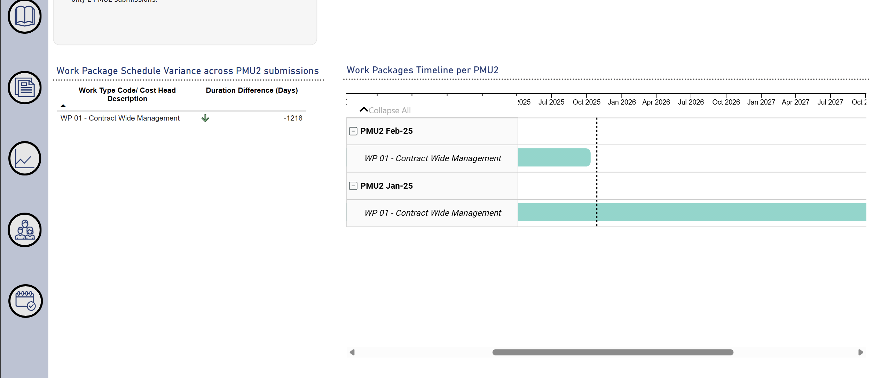
Time Intelligence: The Cost Impact of Schedule Changes
Traditional approach:
Compare baseline vs. current schedule manually
Identify delays after they've happened
React to problems rather than anticipate
Intelligent approach:
Automated schedule comparison at multiple points
Early warning indicators
Cost implications calculated automatically
Scenario modeling for decisions
Why This Matters for QS:
Schedule delays = cost overruns (preliminaries, escalation, damages)
Time extensions = commercial claims
Acceleration = premium costs
Understanding schedule = protecting commercial position
Common Time-Cost Scenarios:
Extended preliminaries due to delays
Acceleration costs (overtime, additional resources)
Market escalation during delays
Liquidated damages exposure
Loss of productivity from compression
Notes:
Presenter Notes:
QS professionals must understand schedule dynamics
Time intelligence connects scheduling to commercial impact
This is where QS and planning converge
Transition: "Let me show you practical techniques"

Slide 19
Use Case - Predicting Schedule Performance with Historical Data
Step 1
Build Historical Database
Collect schedule data from past projects
Include: planned vs. actual durations, delay causes, project characteristics
Minimum dataset: 20-30 projects for basic models
More data = better predictions
Step 2
Identify Patterns
Which activity types consistently run long?
What factors correlate with delays? (weather, procurement, design changes)
Are there seasonal patterns?
Which trades are most variable?
Step 3
Build Predictive Models
Use regression analysis or machine learning
Input variables: activity type, duration, dependencies, time of year, project complexity
Output: Predicted actual duration, confidence interval, delay probability
Step 4
Apply to Current Projects
Feed current schedule data into model
Generate predictions for each activity
Highlight high-risk activities
Update predictions as project progresses

Slide 20
Risk Intelligence: Quantifying Uncertainty
Qualitative Approaches:
Risk registers with "High/Medium/Low" ratings
Contingency as fixed percentage (10%, 15%, 20%)
Based on experience and intuition
Difficult to justify or defend
Why This Falls Short:
Subjective and inconsistent
Doesn't reflect true probability distributions
Can't combine multiple risks mathematically
Leads to over/under-estimation
Doesn't support informed decision-making
Quantitative Risk Analysis (QRA):
Express uncertainty as probability distributions
Use simulation to understand combined effects
Calculate statistically-based contingency
Provide confidence levels for estimates

Slide 21
Quantitative Risk Assessment - Overview
For Estimators:
Defensible contingency calculations
Understanding what drives project risk
Better estimates over time (learning)
For Clients:
Understand probability of budget success
Make informed decisions about risk mitigation
Choose appropriate contingency levels
For Commercial Teams:
Support claims with probability analysis
Understand exposure and opportunity
Negotiate from position of knowledge
Common Applications:
Cost estimate risk analysis
Schedule risk analysis (using Monte Carlo)
Combined cost-schedule risk analysis
Bid/no-bid decisions
Value engineering trade-off analysis

Slide 22
Quantitative Risk Assessment – Key Concepts
1. Probability Distributions, Not Single Points:
Traditional: "This will cost £100,000"
Risk Intelligence: "This will cost £80K-£130K with most likely around £100K"
Represents the reality of uncertainty
2. Understanding Risk Types:
Known risks: We know what might happen (weather delays, price escalation)
Unknown risks: We know there will be surprises, but not what
Both can be modeled statistically
3. Risk Impact on Overall Project:
Individual risks combine in complex ways
Some risks correlate (e.g., market conditions affect multiple costs)
Need simulation to understand total exposure
4. Confidence-Based Decision Making:
"We're 70% confident we can deliver for £10M"
"We're 90% confident it won't exceed £11M"
Allows stakeholders to choose their risk tolerance
Notes:
Presenter Notes:
This is where the rubber meets the road
Moving from opinions to evidence
Powerful for client relationships and claims
Transition: "Let me show you THE technique for risk analysis"

Slide 23
Act 3 - The AI & Machine Learning Frontier

Slide 24
Artificial Intelligence: Separating Hype from Reality
Current Reality (What Works Today):
Document analysis: Extract data from PDFs, drawings, specs
Image recognition: Identify defects, track progress from photos
Predictive analytics: Forecast costs, schedules, risks (as we discussed)
Natural language processing: Understand and generate text
Pattern recognition: Detect anomalies in data
Emerging Applications (Maturing Now):
Generative design: AI suggests design alternatives
Automated quantity take-off: Computer vision measuring drawings
Chatbots for specifications: Query project documents conversationally
Optimization: Best sequencing, resource allocation
Risk prediction: Early warning systems
Future Potential (3-5 Years):
Fully automated estimating: AI generates complete estimates
Real-time cost tracking: IoT + AI for live cost management
Autonomous site monitoring: Drones + AI for progress tracking
Integrated project intelligence: All data sources connected and analyzed

Slide 25
Practical QS Applications (Using General LLMs)
Specification Review:
Prompt: "Review this specification and identify any ambiguous requirements"
LLM analyzes text, flags issues
Saves hours of manual review
BOQ Description Writing:
Prompt: "Generate standard BOQ descriptions for concrete works"
LLM produces consistent, professional descriptions
Speeds up BOQ preparation
Meeting Minutes:
Prompt: "Summarize this meeting transcript into key decisions and action items"
LLM extracts structure from conversation
Reduces admin time
Query Responses:
Prompt: "Draft a response to this contractor query about foundation specification"
LLM generates professional starting point
Human refines and sends
Research and Learning:
Prompt: "Explain the differences between NEC and JCT payment provisions"
LLM provides educational content
Accelerates learning curve
Excel/Python Assistance:
Prompt: "Write a Python script to calculate escalation on a cost breakdown"
LLM generates working code
Democratizes programming

Slide 26
LLMs – Where they Fall Short, Solution & Use Case
Drawbacks
Lack of Specialised Knowledge
Hallucinations
Context Window Limit
Hard to explain current context
Inconsistency
Solution - Fine-Tuning
Adapt LLMs to your specific needs
Train on your data and standards
Create specialized QS assistants
Get consistency and accuracy

Slide 27
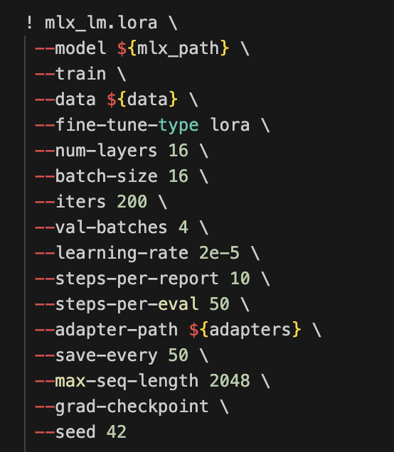
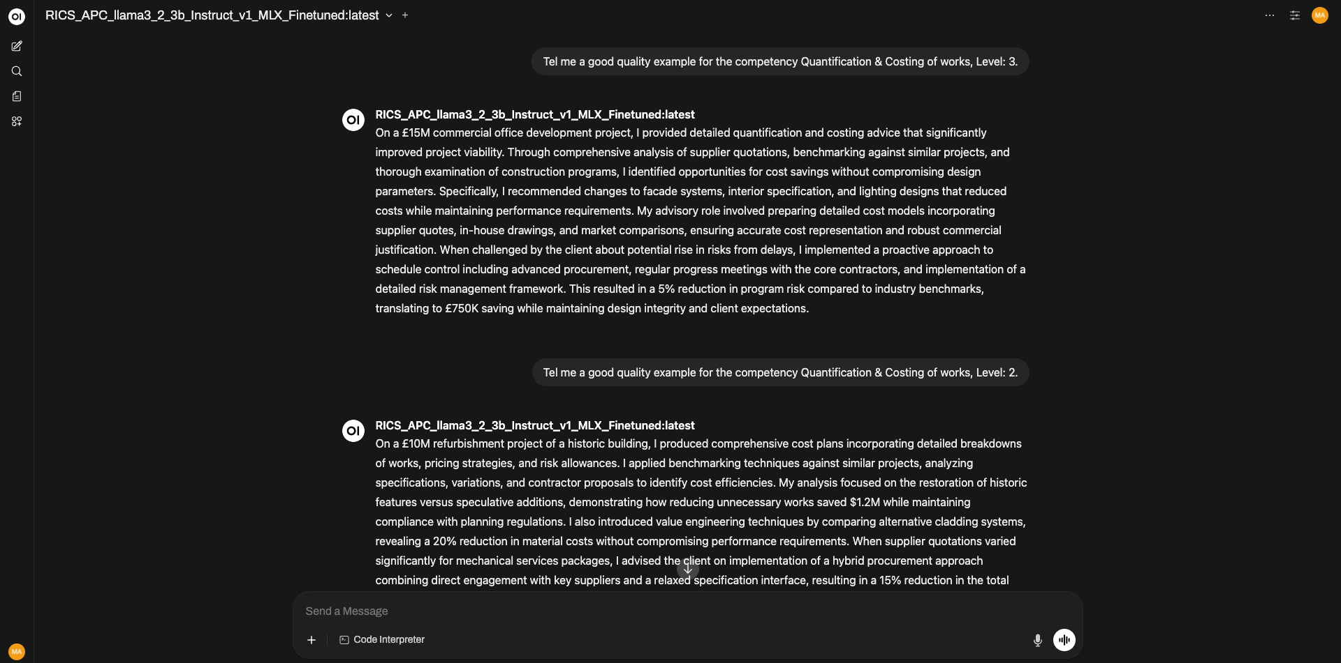
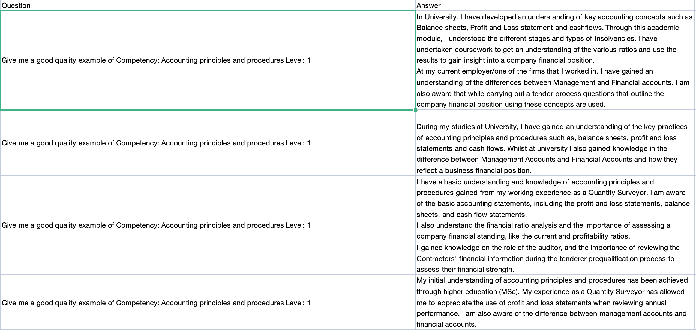
Fine-tuning LLMs (Use Case)
Step 1 - Data Collection
Step 2 – Adjusting Hyperparameters & Finetuning
Step 3 – Testing & Deployment

Slide 28
Act 4 - Digital Skillset

Slide 29
The Modern QS: Hybrid Professional
Traditional Skills (Still Essential):
Measurement and quantification
Contract knowledge
Commercial acumen
Cost management
Communication
New Essential Skills:
Data literacy: Understanding and analyzing data
Programming basics: Automation and analysis
AI fluency: Using and managing AI tools
Digital tools: Modern software and platforms
Analytical thinking: Problem-solving with data
The Value Proposition:
Traditional skills + Digital skills = 10x productivity and strategic impact
Notes:
There are multiple use cases about the 10x productivity:
Documentation of Dashboards (TMDL to reports)
Learning Python & DAX
Creating repetitive DAX Measures
Converting PDFs into proper tables.

Slide 30
Why Every QS Should Code (A Little)
Why Learn Programming
Automate repetitive tasks (save hours weekly)
Analyze large datasets (impossible manually)
Build custom tools (exactly what you need)
Understand AI systems (not a black box)
Future-proof career
Python
Data analysis: pandas, numpy
Visualization: matplotlib
Automation: reading/writing Excel
Easy to learn, powerful for QS tasks
Data Types & Structure
Structured vs. unstructured
Tabular data (rows/columns)
Relational data (linked tables)
Time series data
Data Visualization
Choosing right chart types
Telling stories with data
Dashboard design
Avoiding misleading graphics
Critical Thinking About Data
Data quality assessment
Bias identification
Correlation vs. causation
Sample size and confidence
Practical QS Applications:
Interpret cost data distributions
Spot anomalies in quotes
Present findings to clients
Challenge assumptions with evidence

Slide 31







Learning Journey Map
Text Functions
Spill Functions
Merge
Append
Basic M language
Basic PowerQuery Functions
Pivot/Unpivot Columns
Add Custom Columns
DAX functions
Data Modelling
Pivot Charts
Pandas & Numpy.
Data cleansing techniques
Scikit learn for Machine Learning
AI
Sentimental Analysis
Generative LLMs
Basic Flows
AI Builder
Integration with various data sources
Canvas Apps
Integration with data sources
Dataverse
Data Flows
Application feel
Integration with Power BI
DAX functions
Data Modelling
Basic and Custom Visuals
Dashboard Format
Bookmarks
Application feel
Integration with multiple data sources
Data Flows & Data Marts

Slide 32
Act 5 - Bringing It Together

Slide 33
Putting It All Together
Stage 1
Capture project data systematically
Structure for analysis
Build benchmark database
Stage 2
Apply cost/time/risk analytics
Generate insights and predictions
Inform estimates
Stage 3
Automated wireframing
Document analysis
Consistency checks
Stage 4
Faster, more accurate outputs
Evidence-based recommendations
Professional presentations
Stage 5
Feedback loop to benchmarks
Continuous improvement
Knowledge building
Learning
Delivery
AI Assistance
Intelligence
Data Collection

Slide 34
Why Invest in Digital Transformation
Efficiency Gains:
30-70% time savings on routine tasks
Faster tender turnaround
Reduced rework and errors
Quality Improvements:
More accurate estimates
Better risk quantification
Evidence-based decisions
Competitive Advantage:
Differentiation in market
Attract better talent
Win more work
Financial Impact:
Typical ROI: 200-500% in Year 1
Lower operational costs
Higher margins
Reduced risk exposure

Slide 35
What's Next: The Road Ahead"
Near Term (1-3 Years):
AI assistants commonplace
Automated measurement standard
Real-time cost intelligence
Digital twins integration
Medium Term (3-7 Years):
End-to-end digital workflows
Predictive project intelligence
Blockchain for payments/tracking
Fully integrated ecosystems
Your Role:
Strategic advisor, not cost accountant
AI supervisor, not replaceable by AI
Data interpreter, not data entry
Relationship builder with tech superpowers

Slide 36


